Slide 1
AIR QUALITY ANALYSIS IN TAMILNADU
PRESENTED BY,
M.ABIRAMI
M.KALAIYARASI
T.SHIVARANJANI
M.YUKESHWARI

Slide 2
OBJECTIVES
1)APPLYING ML MODEL(REGULARIZATION)
2) SPLITTING THE TRAINING AND TESTING DATA
3)CREATING DASHBOARD USING IBM COGNOS
4)CREATING REPORT USING IBM COGNOS
5)STATISTICAL TESTS USING TREEMAP

Slide 3
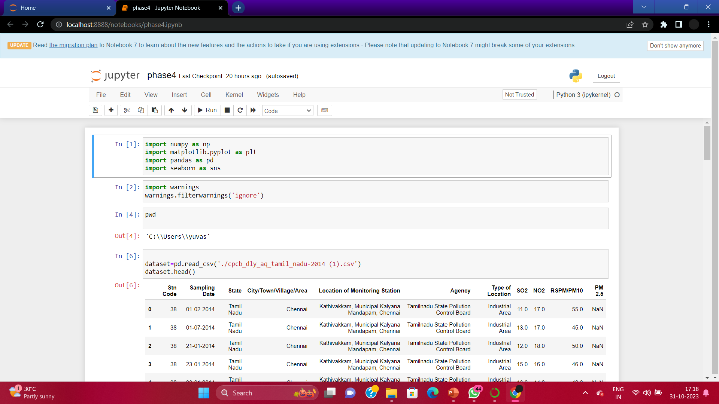
Step 1:split the dataset into test data and train data

Slide 4
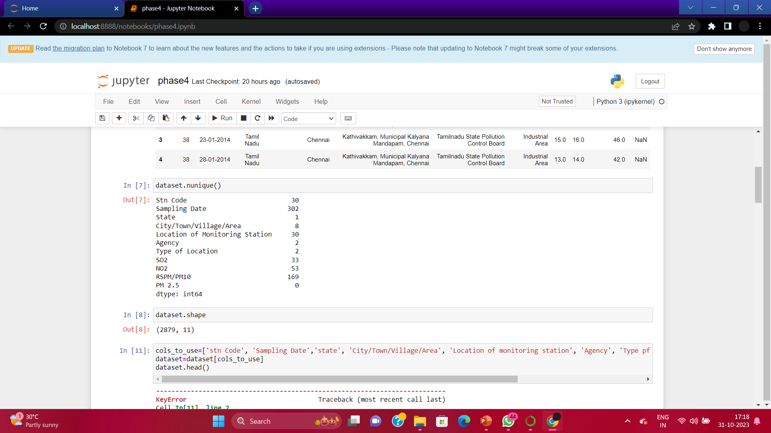
Step 2:Applying the regularization model to the dataset

Slide 5
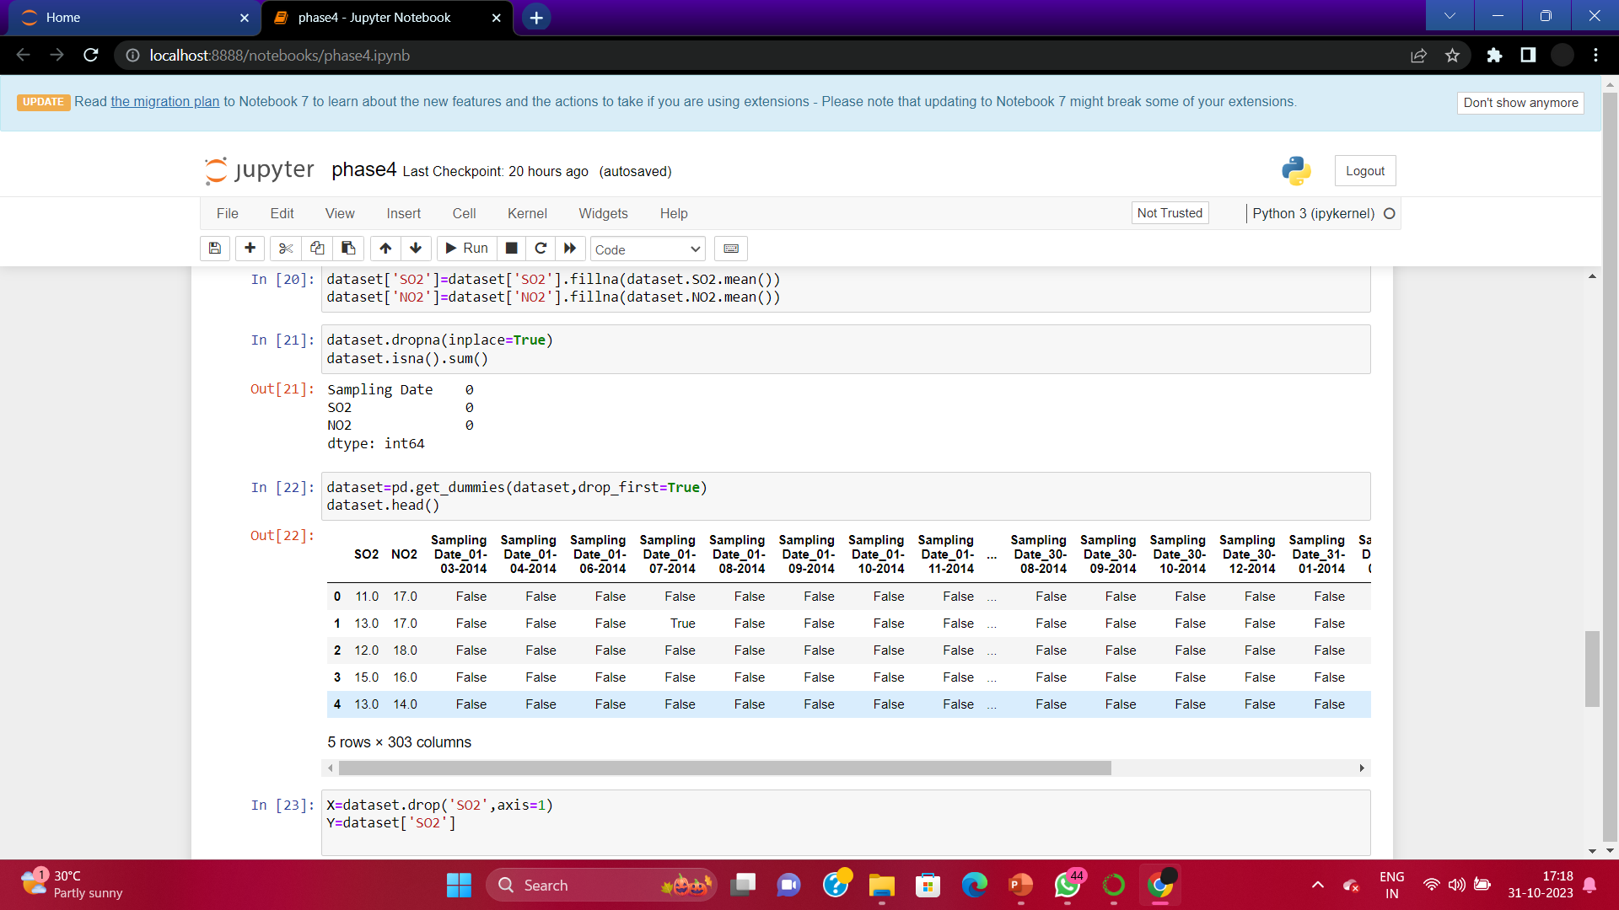
Step 3:Calculating the loss value

Slide 6
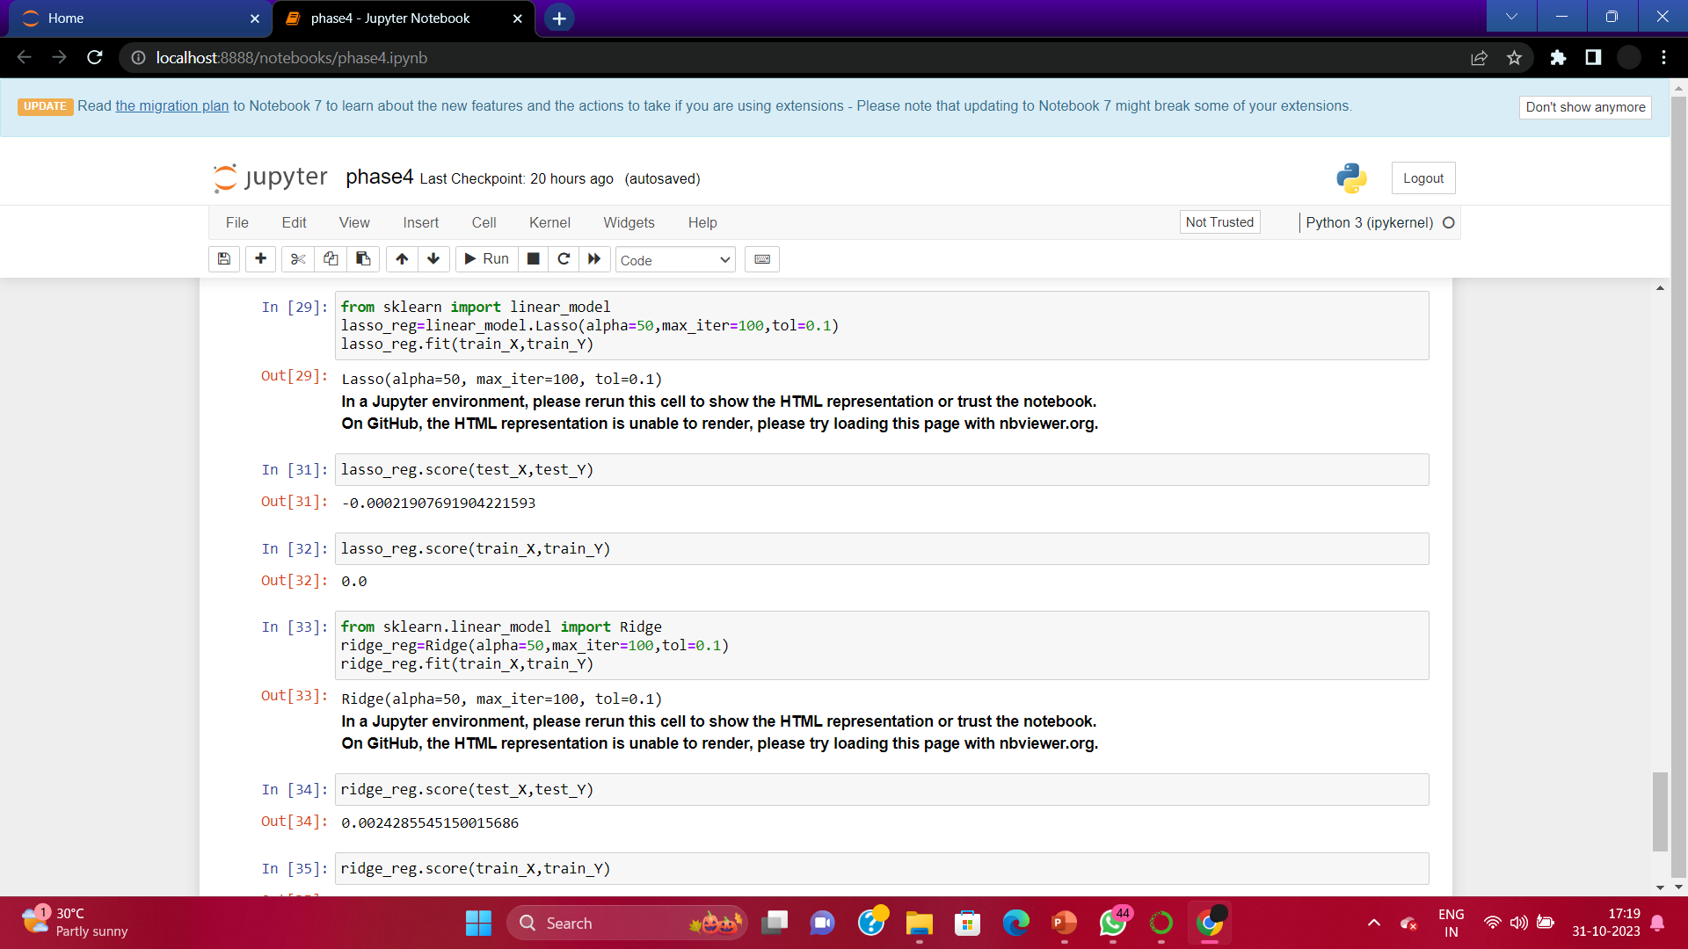
step:4 calculate the accuracy

Slide 7
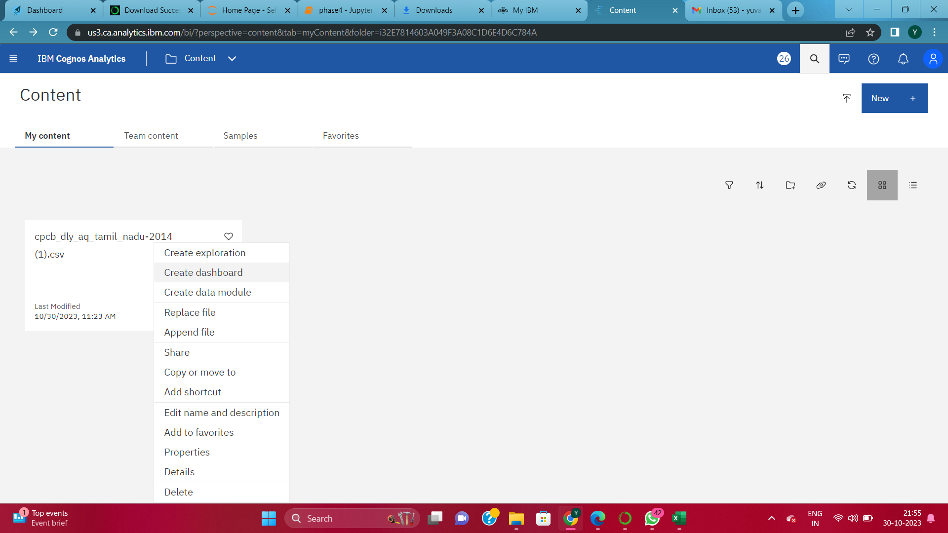
Step 5: CREATING DASHBOARD USING IBM COGNOS

Slide 8
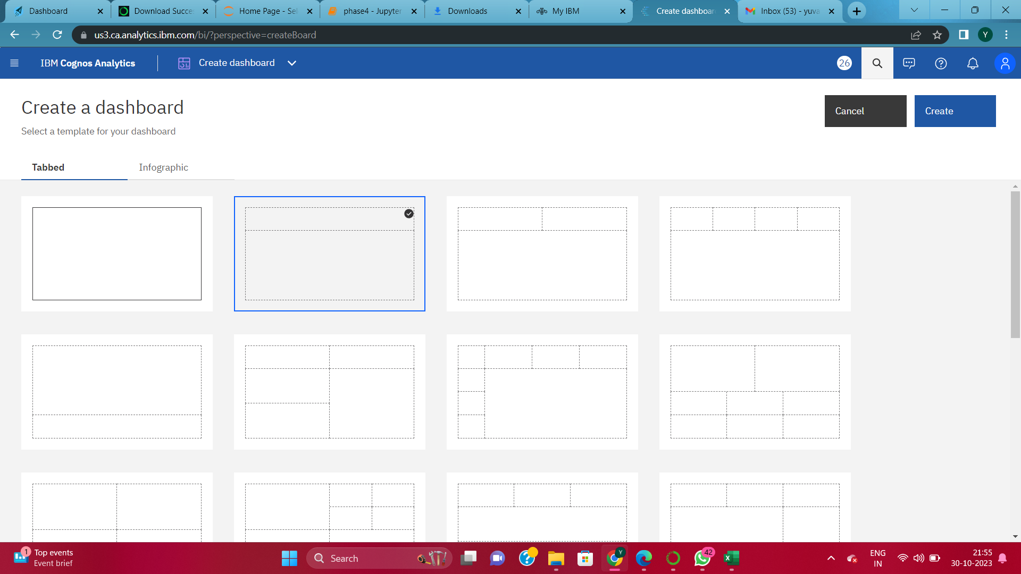

Slide 9
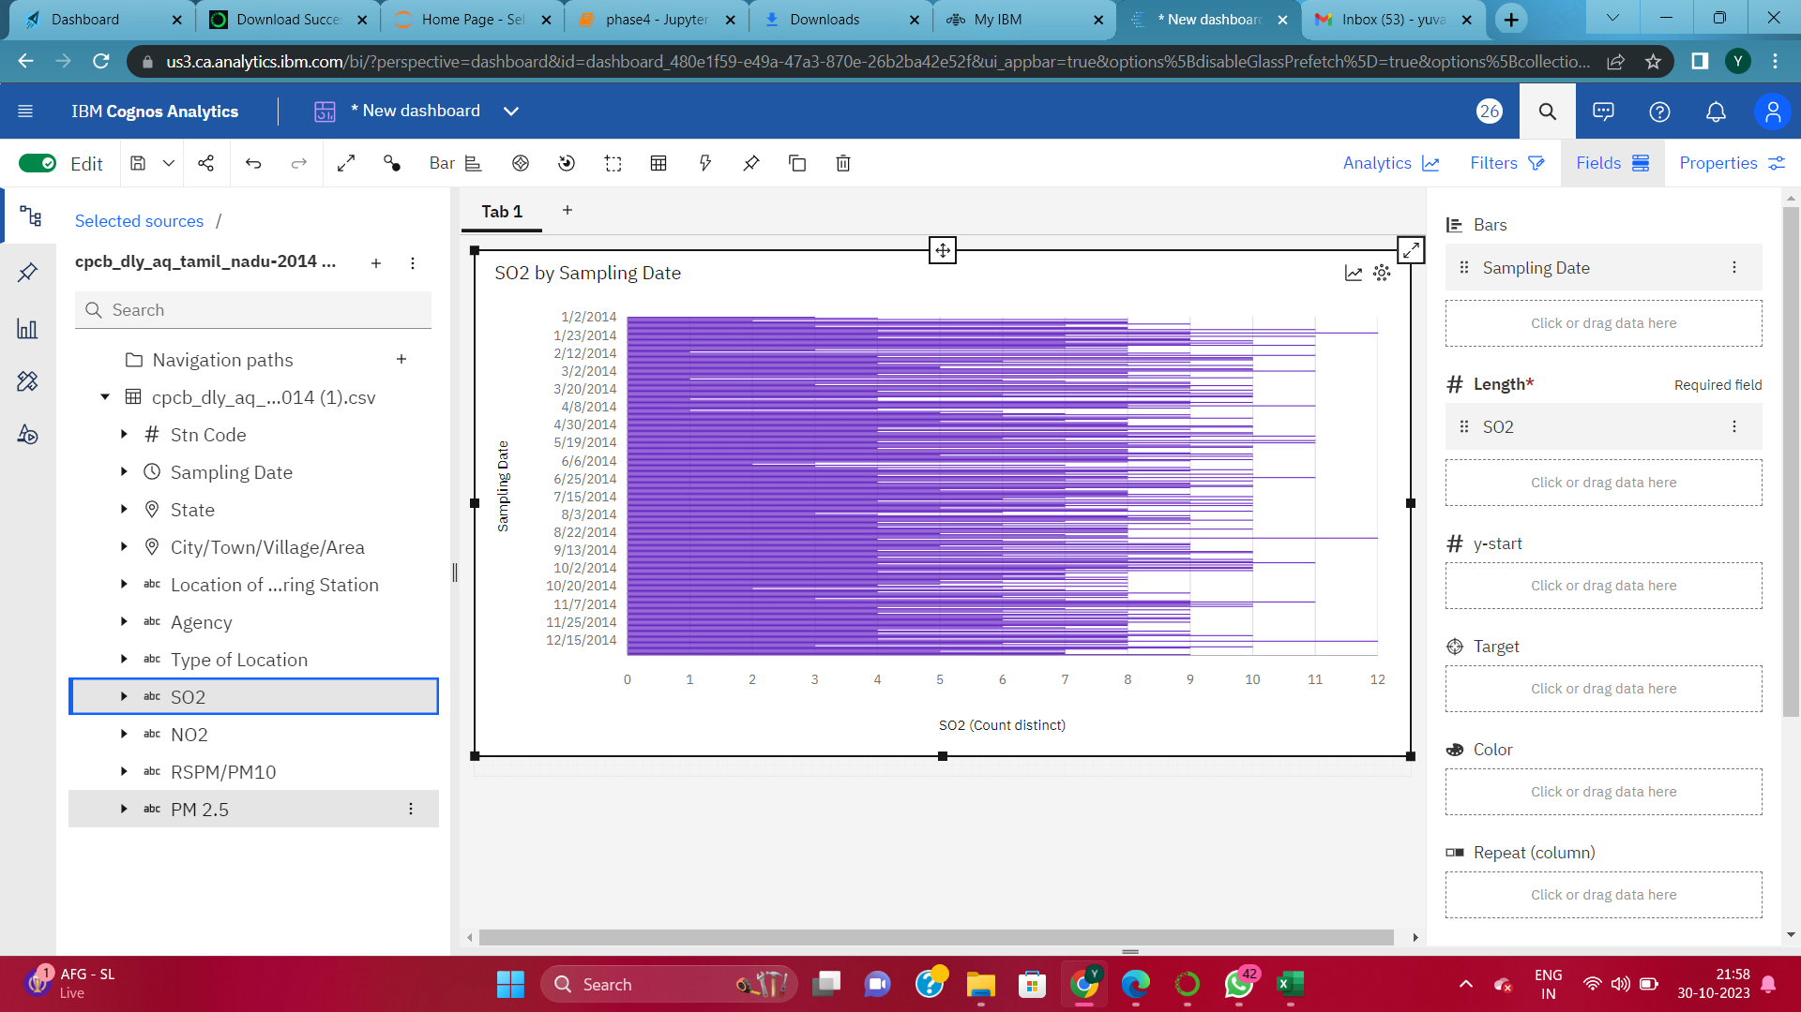
Creating bar graph using dashboard

Slide 10
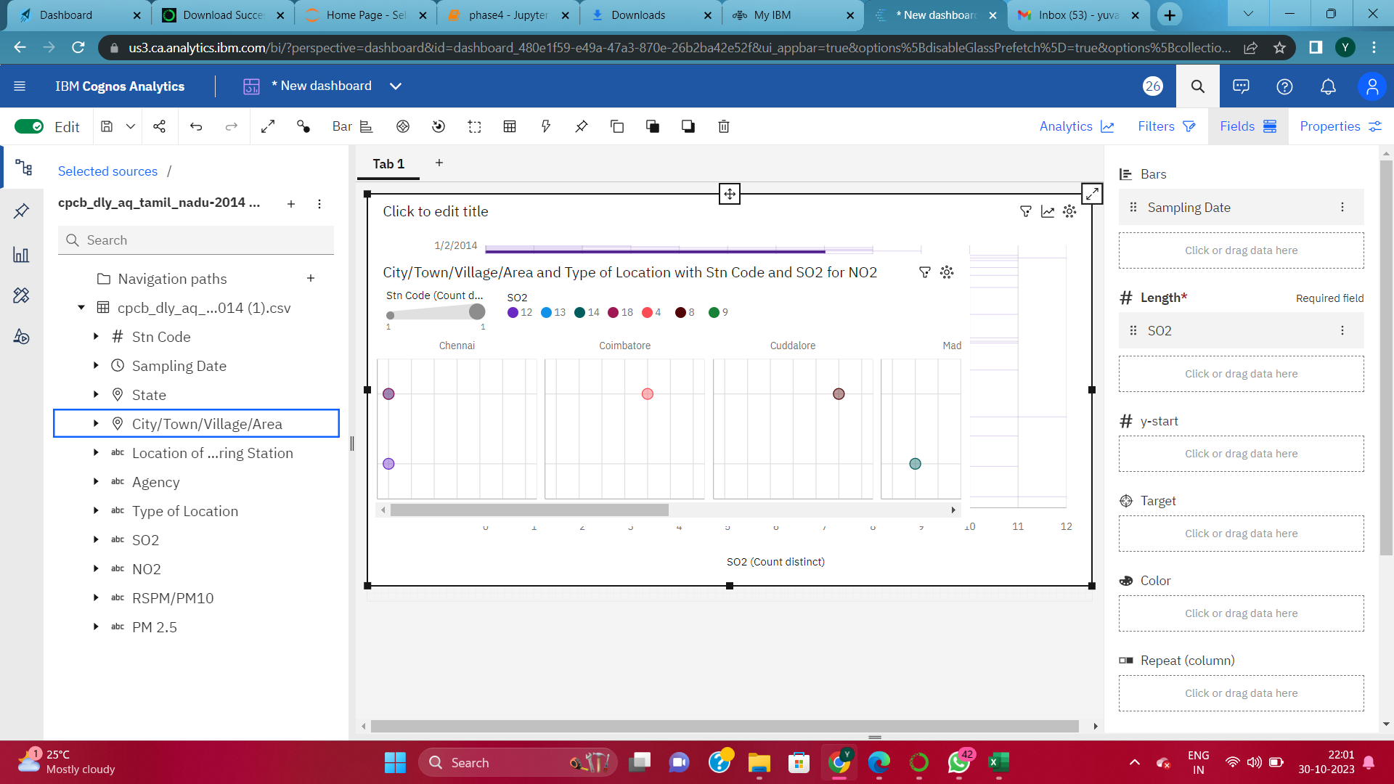
Creating packed ball structure using dashboard

Slide 11
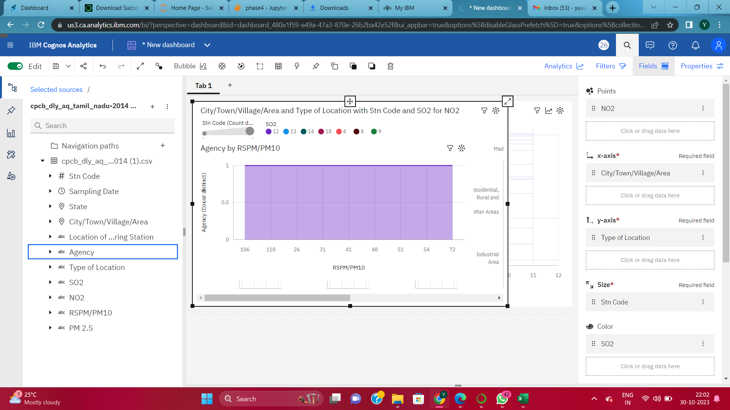

Slide 12
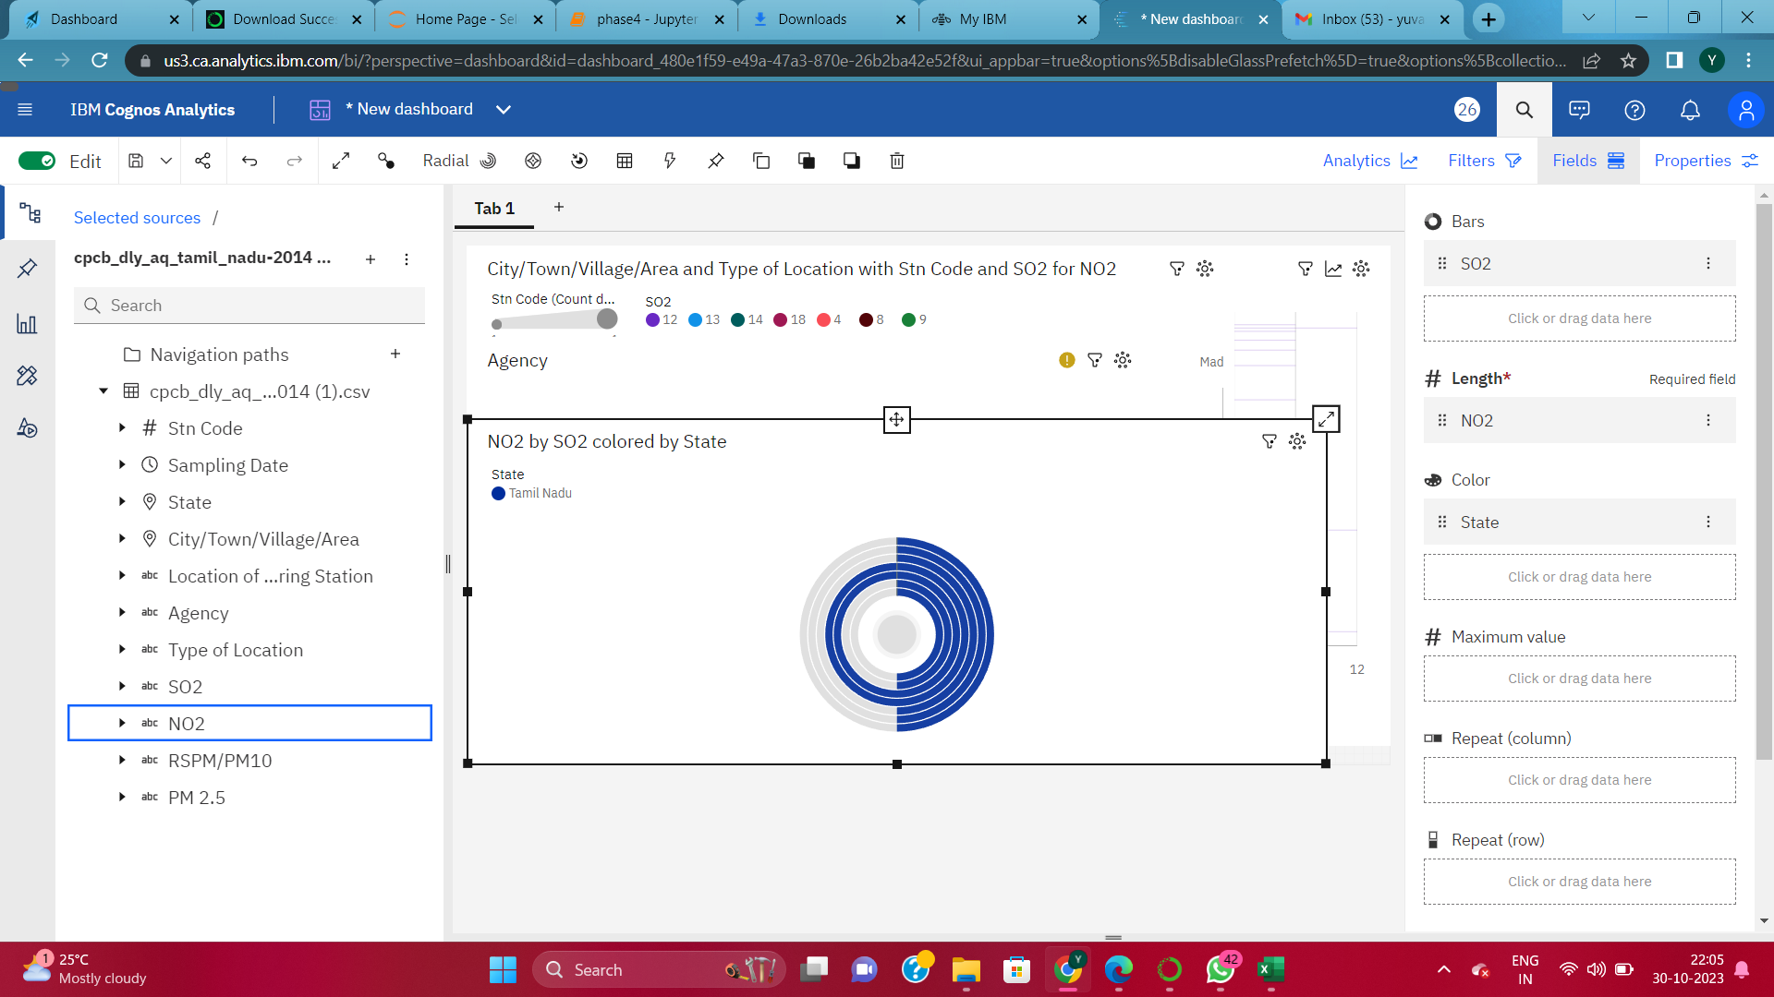
Creating area using dashboard

Slide 13
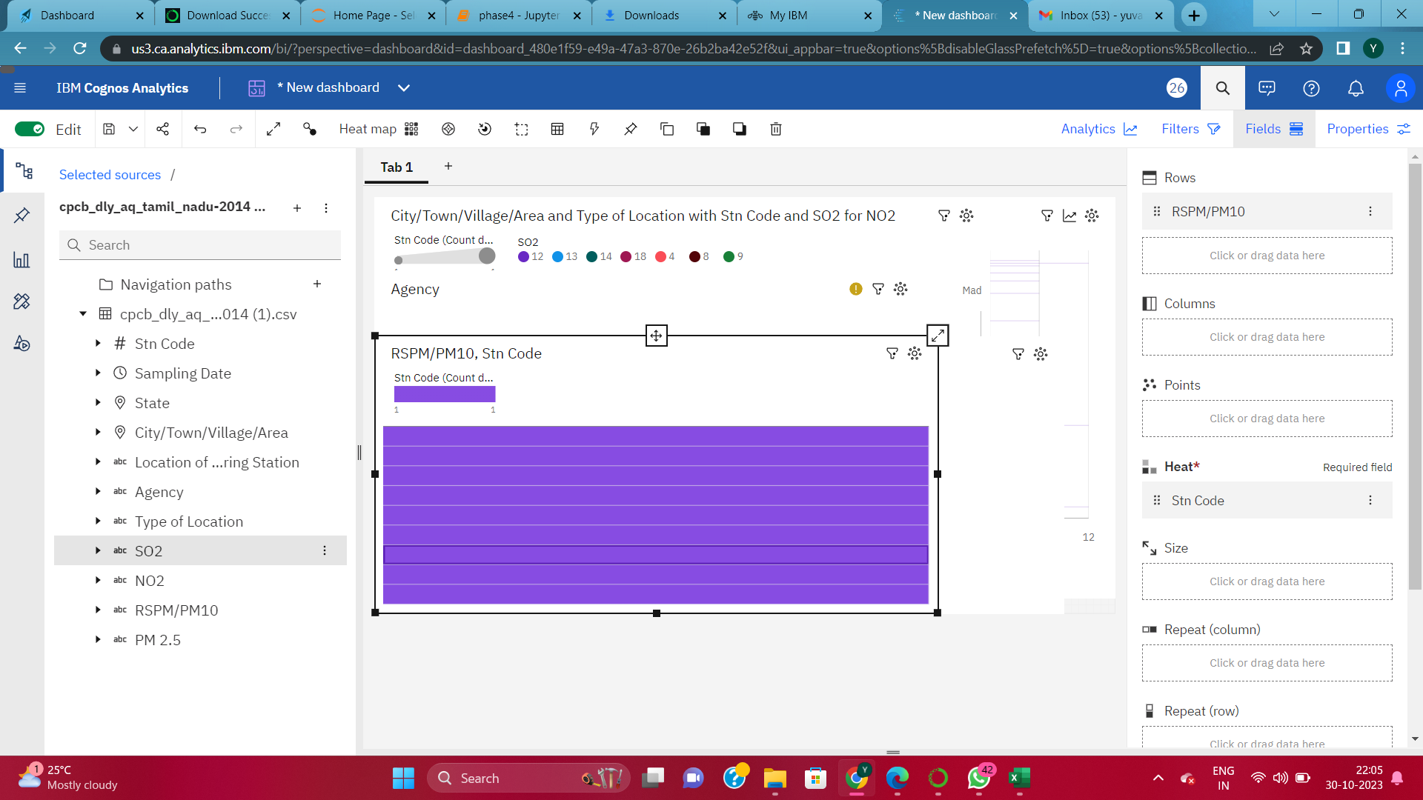

Slide 14
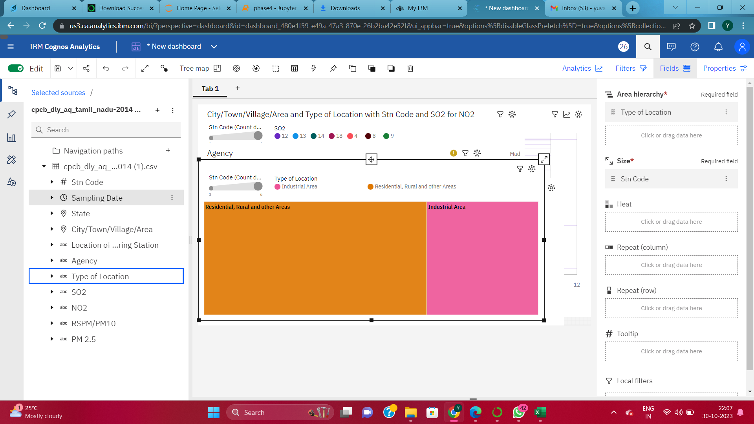

Slide 15
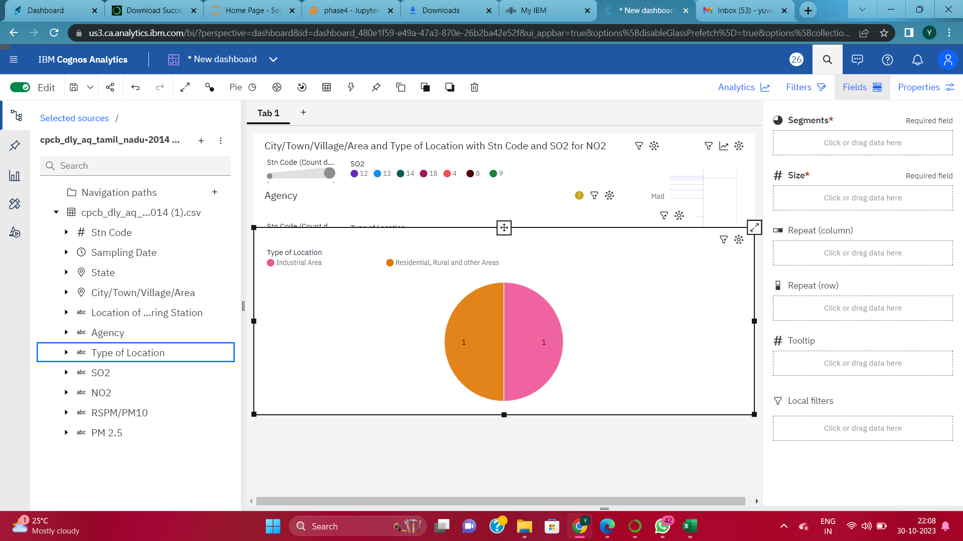

Slide 16
THANK YOU

